Slide 1
Slides for Fuzzy Sets, Ch. 2 of
Neuro-Fuzzy and Soft Computing
Neuro-Fuzzy and Soft Computing: Fuzzy Sets
J.-S. Roger Jang (張智星)
CS Dept., Tsing Hua Univ., Taiwan
http://www.cs.nthu.edu.tw/~jang
jang@cs.nthu.edu.tw
Notes:
115/11/08
...
In this talk, we are going to apply two neural network controller design techniques to fuzzy controllers, and construct the so-called on-line adaptive neuro-fuzzy controllers for nonlinear control systems. We are going to use MATLAB, SIMULINK and Handle Graphics to demonstrate the concept. So you can also get a preview of some of the features of the Fuzzy Logic Toolbox, or FLT, version 2.

Slide 2
Fuzzy Sets: Outline
Introduction
Basic definitions and terminology
Set-theoretic operations
MF formulation and parameterization
  MFs of one and two dimensions
  Derivatives of parameterized MFs
More on fuzzy union, intersection, and complement
  Fuzzy complement
  Fuzzy intersection and union
  Parameterized T-norm and T-conorm
Notes:
115/11/08
Specifically, this is the outline of the talk. Wel start from the basics, introduce the concepts of fuzzy sets and membership functions. By using fuzzy sets, we can formulate fuzzy if-then rules, which are commonly used in our daily expressions. We can use a collection of fuzzy rules to describe a system behavior; this forms the fuzzy inference system, or fuzzy controller if used in control systems. In particular, we can can apply neural networks?learning method in a fuzzy inference system. A fuzzy inference system with learning capability is called ANFIS, stands for adaptive neuro-fuzzy inference system. Actually, ANFIS is already available in the current version of FLT, but it has certain restrictions. We are going to remove some of these restrictions in the next version of FLT. Most of all, we are going to have an on-line ANFIS block for SIMULINK; this block has on-line learning capability and it ideal for on-line adaptive neuro-fuzzy control applications. We will use this block in our demos; one is inverse learning and the other is feedback linearization.

Slide 3
Fuzzy Sets
Sets with fuzzy boundaries
A = Set of tall people
Crisp set A
Fuzzy set A
1.0
1.0
.9
.5
Membership
function
5’10’’
Heights
5’10’’
6’2’’
Heights
Notes:
115/11/08
A fuzzy set is a set with fuzzy boundary. Suppose that A is the set of tall people. In a conventional set, or crisp set, an element is either belong to not belong to a set; there nothing in between. Therefore to define a crisp set A, we need to find a number, say, 5??, such that for a person taller than this number, he or she is in the set of tall people. For a fuzzy version of set A, we allow the degree of belonging to vary between 0 and 1. Therefore for a person with height 5??, we can say that he or she is tall to the degree of 0.5. And for a 6-foot-high person, he or she is tall to the degree of .9. So everything is a matter of degree in fuzzy sets. If we plot the degree of belonging w.r.t. heights, the curve is called a membership function. Because of its smooth transition, a fuzzy set is a better representation of our mental model of all? Moreover, if a fuzzy set has a step-function-like membership function, it reduces to the common crisp set.

Slide 4
Membership Functions (MFs)
Characteristics of MFs:
  Subjective measures
  Not probability functions
MFs
“tall” in Asia
.8
.5
“tall” in the US
“tall” in NBA
.1
5’10’’
Heights
Notes:
115/11/08
Here I like to emphasize some important properties of membership functions. First of all, it subjective measure; my membership function of all?is likely to be different from yours. Also it context sensitive. For example, I 5?1? and I considered pretty tall in Taiwan. But in the States, I only considered medium build, so may be only tall to the degree of .5. But if I an NBA player, Il be considered pretty short, cannot even do a slam dunk! So as you can see here, we have three different MFs for all?in different contexts. Although they are different, they do share some common characteristics --- for one thing, they are all monotonically increasing from 0 to 1. Because the membership function represents a subjective measure, it not probability function at all.

Slide 5
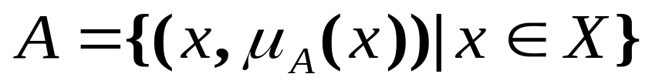
Fuzzy Sets
Formal definition:
  A fuzzy set A in X is expressed as a set of ordered pairs:
Membership
function
(MF)
Universe or
universe of discourse
Fuzzy set
A fuzzy set is totally characterized by a
membership function (MF).

Slide 6
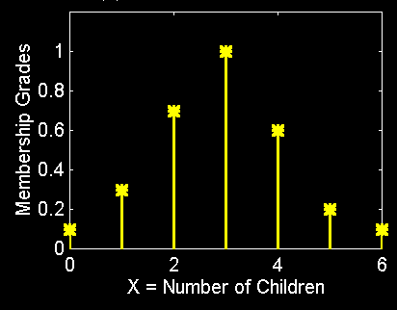
Fuzzy Sets with Discrete Universes
Fuzzy set C = “desirable city to live in”
  X = {SF, Boston, LA} (discrete and nonordered)
  C = {(SF, 0.9), (Boston, 0.8), (LA, 0.6)}
Fuzzy set A = “sensible number of children”
  X = {0, 1, 2, 3, 4, 5, 6} (discrete universe)
  A = {(0, .1), (1, .3), (2, .7), (3, 1), (4, .6), (5, .2), (6, .1)}

Slide 7
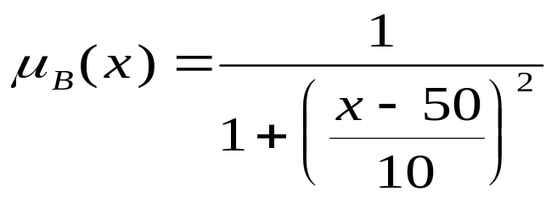
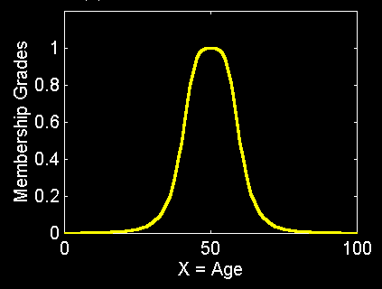
Fuzzy Sets with Cont. Universes
Fuzzy set B = “about 50 years old”
  X = Set of positive real numbers (continuous)
  B = {(x, μB(x)) | x in X}

Slide 8
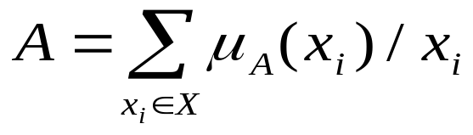
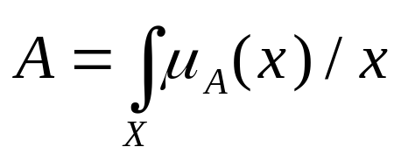
Alternative Notation
A fuzzy set A can be alternatively denoted as follows:
X is discrete
X is continuous
Note that Σ and integral signs stand for the union of membership grades; “/” stands for a marker and does not imply division.

Slide 9
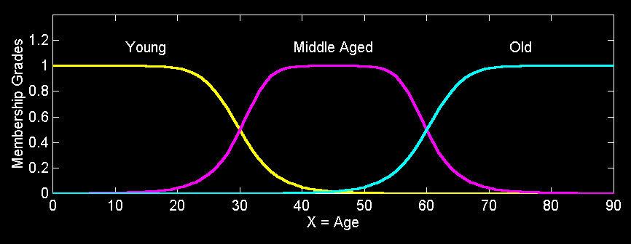
Fuzzy Partition
Fuzzy partitions formed by the linguistic values “young”, “middle aged”, and “old”:
lingmf.m

Slide 10
More Definitions
Support
Core
Normality
Crossover points
Fuzzy singleton
α-cut, strong α-cut
Convexity
Fuzzy numbers
Bandwidth
Symmetricity
Open left or right, closed

Slide 11
MF Terminology
MF
1
.5
α
0
Core
X
Crossover points
α - cut
Support

Slide 12
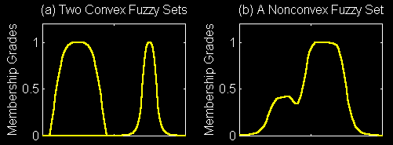
Convexity of Fuzzy Sets
A fuzzy set A is convex if for any λ in [0, 1],
Alternatively, A is convex is all its α-cuts are convex.
convexmf.m

Slide 13
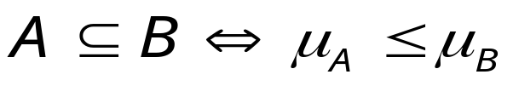
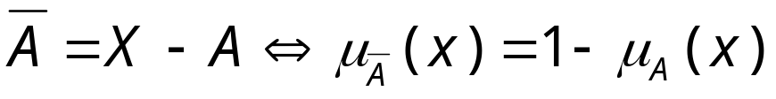
Set-Theoretic Operations
Subset:
Complement:
Union:
Intersection:

Slide 14
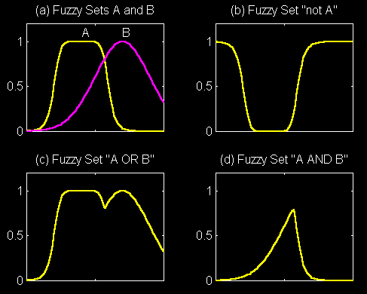
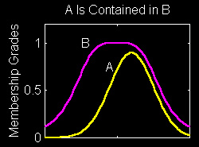
Set-Theoretic Operations
subset.m
fuzsetop.m

Slide 15
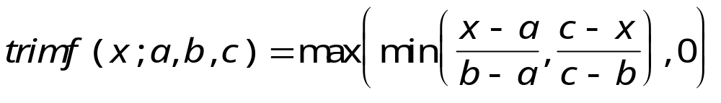
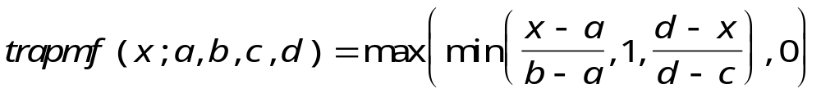
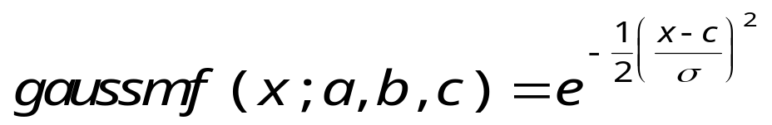
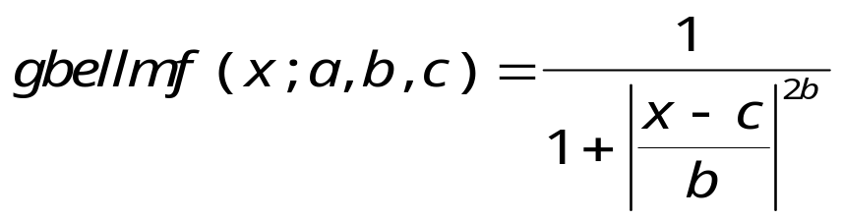
MF Formulation
Triangular MF:
Trapezoidal MF:
Gaussian MF:
Generalized bell MF:

Slide 16
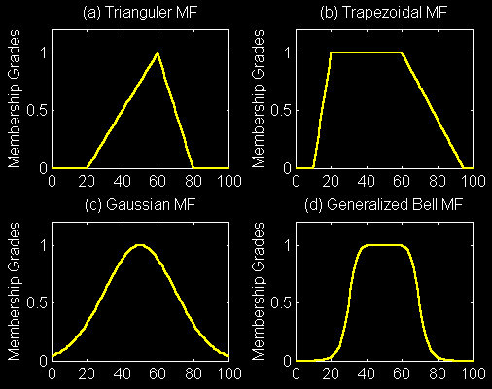
MF Formulation
disp_mf.m

Slide 17
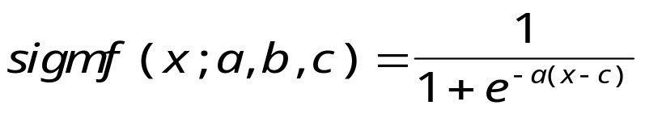
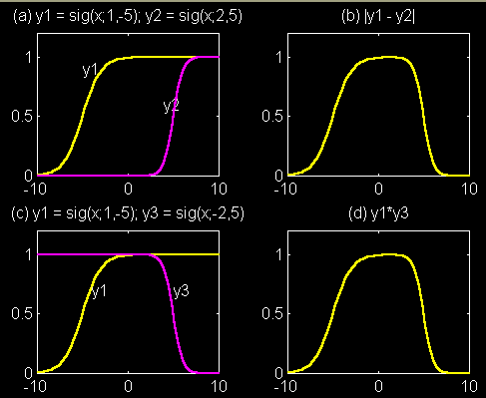
MF Formulation
Sigmoidal MF:
Extensions:
  Abs. difference
  of two sig. MF
  Product
  of two sig. MF
disp_sig.m

Slide 18
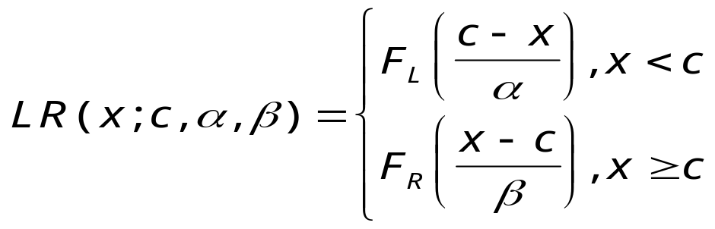
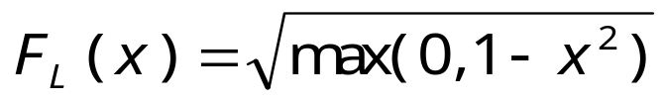
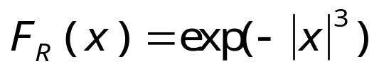
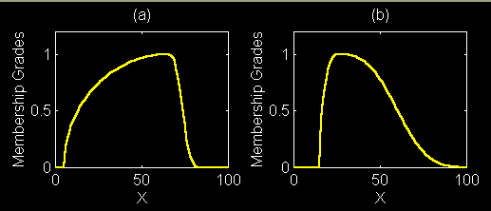
MF Formulation
L-R MF:
Example:
c=65
a=60
b=10
c=25
a=10
b=40
difflr.m

Slide 19
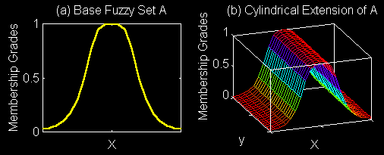
Cylindrical Extension
Base set A
Cylindrical Ext. of A
cyl_ext.m

Slide 20
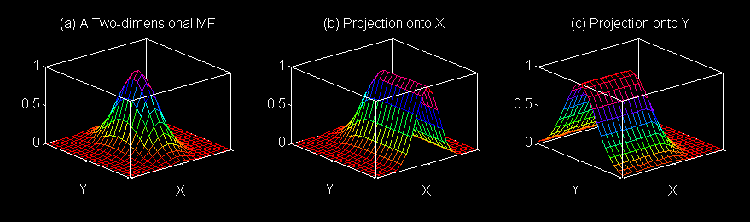

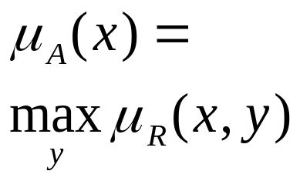
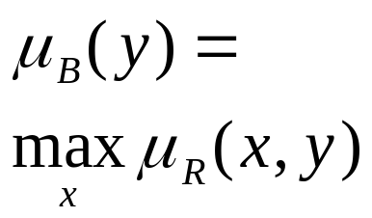
2D MF Projection
Two-dimensional
MF
Projection
onto X
Projection
onto Y
project.m

Slide 21
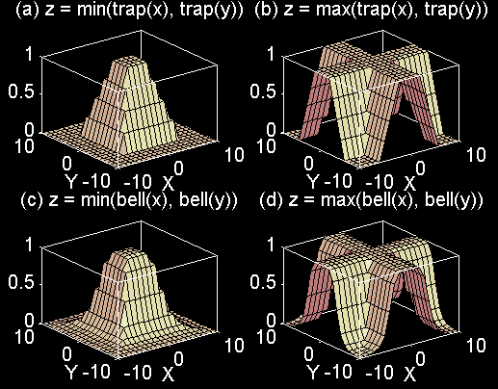
2D MFs
2dmf.m

Slide 22
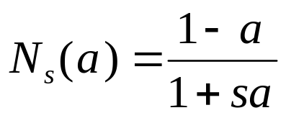

Fuzzy Complement
General requirements:
  Boundary: N(0)=1 and N(1) = 0
  Monotonicity: N(a) > N(b) if a < b
  Involution: N(N(a) = a
Two types of fuzzy complements:
  Sugeno’s complement:
  Yager’s complement:

Slide 23
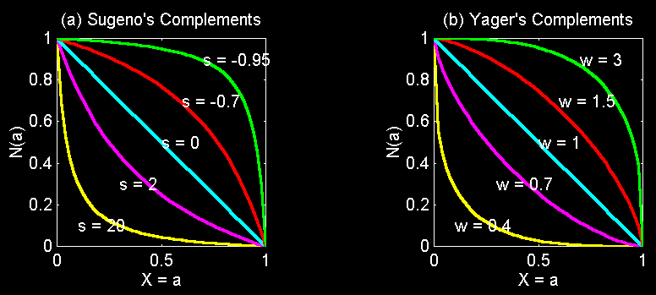
Fuzzy Complement
Sugeno’s complement:
Yager’s complement:
negation.m

Slide 24
Fuzzy Intersection: T-norm
Basic requirements:
  Boundary: T(0, 0) = 0, T(a, 1) = T(1, a) = a
  Monotonicity: T(a, b) < T(c, d) if a < c and b < d
  Commutativity: T(a, b) = T(b, a)
  Associativity: T(a, T(b, c)) = T(T(a, b), c)
Four examples (page 37):
  Minimum: Tm(a, b)
  Algebraic product: Ta(a, b)
  Bounded product: Tb(a, b)
  Drastic product: Td(a, b)

Slide 25
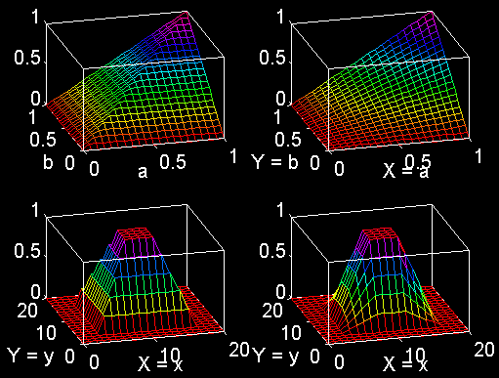
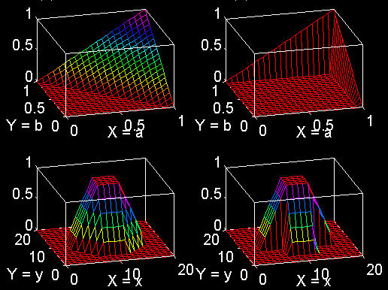
T-norm Operator
Algebraic
product:
Ta(a, b)
Bounded
product:
Tb(a, b)
Drastic
product:
Td(a, b)
Minimum:
Tm(a, b)
tnorm.m

Slide 26
Fuzzy Union: T-conorm or S-norm
Basic requirements:
  Boundary: S(1, 1) = 1, S(a, 0) = S(0, a) = a
  Monotonicity: S(a, b) < S(c, d) if a < c and b < d
  Commutativity: S(a, b) = S(b, a)
  Associativity: S(a, S(b, c)) = S(S(a, b), c)
Four examples (page 38):
  Maximum: Sm(a, b)
  Algebraic sum: Sa(a, b)
  Bounded sum: Sb(a, b)
  Drastic sum: Sd(a, b)

Slide 27
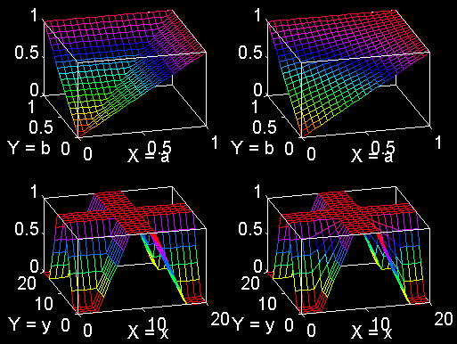
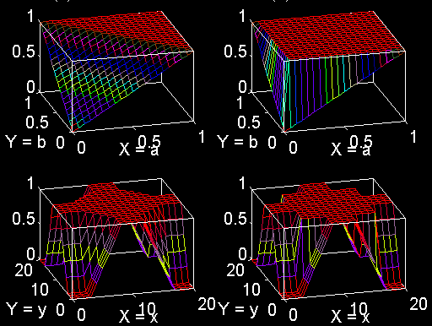
T-conorm or S-norm
Algebraic
sum:
Sa(a, b)
Bounded
sum:
Sb(a, b)
Drastic
sum:
Sd(a, b)
Maximum:
Sm(a, b)
tconorm.m

Slide 28
Generalized DeMorgan’s Law
T-norms and T-conorms are duals which support the generalization of DeMorgan’s law:
  T(a, b) = N(S(N(a), N(b)))
  S(a, b) = N(T(N(a), N(b)))
Tm(a, b)
Ta(a, b)
Tb(a, b)
Td(a, b)
Sm(a, b)
Sa(a, b)
Sb(a, b)
Sd(a, b)

